Slide 1
Applied Data science using Azure
August 22, 2022

Slide 2
Agenda
* Overview on Azure Machine learning
Stages in Data Science Project in Azure.
* Azure Machine Leaning Studio
Model Development in Azure.
Azure ML Workspace.
Data Science VM
Azure Compute Engine
Azure Visual tools- Azure ML Designer & AutoML.
Azure Notebook
* Azure Cognitive Service
Introduction of Azure Cognitive Services.
Working with Azure Cognitive Services.
* Azure Databricks
Introduction of Spark & Azure Databricks.
Working on Azure Databricks.
* Docker
Workflow & Demo of Docker

Slide 3
Prerequisites
Microsoft Azure Subscription with Credits (recommended for lab exercises).
Basics of Python, Machine Learning & Azure Concepts.

Slide 4
Azure Machine Learning
Azure Machine Learning is a separate, and modernized, service that delivers a complete data science platform. It supports both code-based and low-code experiences.
https://docs.microsoft.com/en-us/azure/machine-learning/overview-what-is-azure-machine-learning

Slide 5
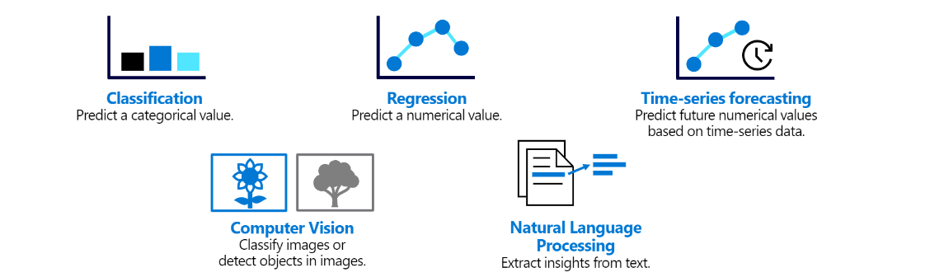
Overview on Azure Machine Learning
1. Define the problem
Decide on what model should predict and when it is successful.

Slide 6
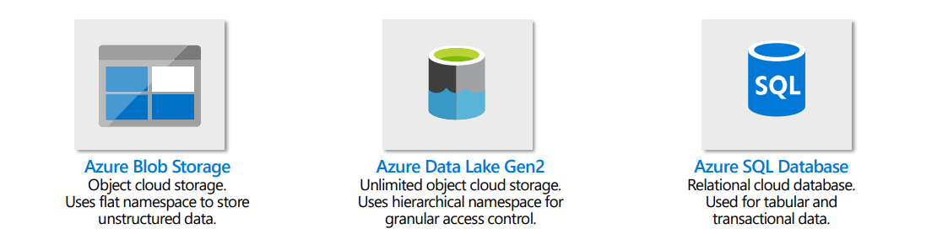
Overview on Azure Machine Learning
2. Get the data
Explore data sources and get access.
Azure Machine Learning connects seamlessly with the three most used Azure storages for data science.

Slide 7
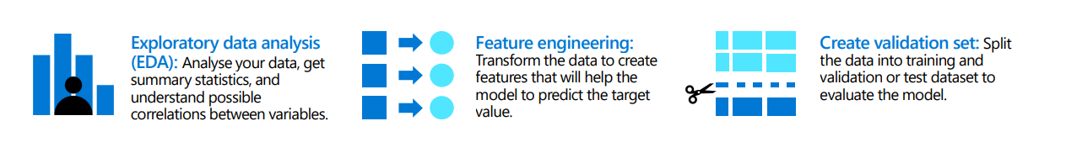
Overview on Azure Machine Learning
3. Prepare the data
Explore the data.
Clean and transform the data based on the model’s requirements.

Slide 8
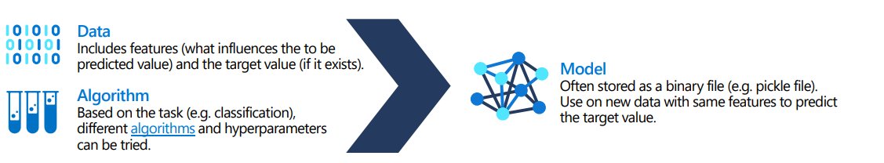
Overview on Azure Machine Learning
4. Train the model
Algorithm selection and hyperparameters tuning.

Slide 9
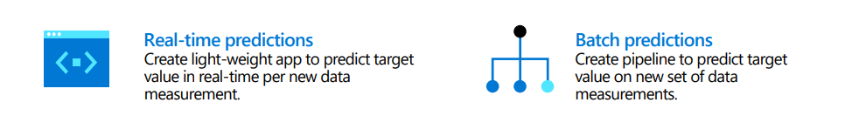
Overview on Azure Machine Learning
5. Integrate the model
Use endpoint to generate predictions.

Slide 10
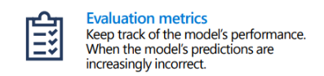
Overview on Azure Machine Learning
6. Monitor the model
Track the model’s performance.

Slide 11
Azure Machine Leaning Studio
It is a web portal in Azure Machine Learning that contains code-based and no-code options for project authoring and asset management.
It offers scalable compute clusters for large-scale training, Enterprise security and governance, Interoperable with popular open-source tools, End-to-end MLOps.
https://docs.microsoft.com/en-us/azure/machine-learning/overview-what-is-machine-learning-studio

Slide 12
Model Development in Azure
ML Pipeline
Datasets
Azure ML Workspace
Develop
Environment
ML Model
Register & Deploy
Training

Slide 13
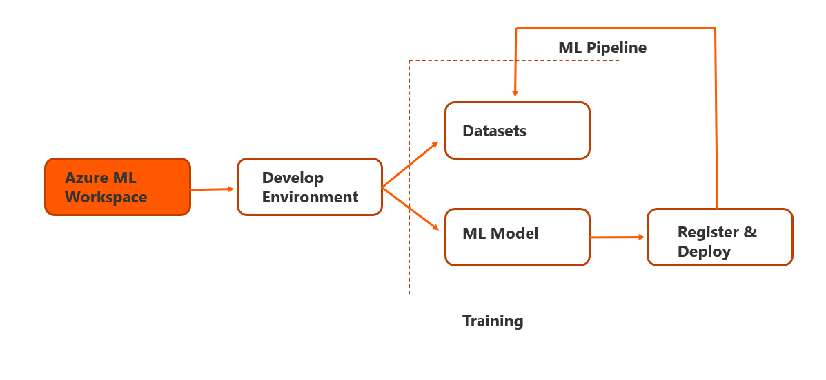
Azure ML Workspace
The workspace is the top-level resource for Azure Machine Learning, providing a centralized place to work with all the artifacts you create when you use Azure Machine Learning.
The workspace keeps a history of all training runs, including logs, metrics, output, and a snapshot of your scripts. You use this information to determine which training run produces the best model.
Once you have a model you like, you register it with the workspace. You then use the registered model and scoring scripts to deploy to Azure Container Instances, Azure Kubernetes Service, or to a field-programmable gate array (FPGA) as a REST-based HTTP endpoint for model inference.
https://docs.microsoft.com/en-us/azure/machine-learning/concept-workspace

Slide 14
Create & Explore an AML Workspace
There are multiple ways to create a workspace:
Use the Azure portal for a point-and-click interface to walk you through each step.
Use the Azure Machine Learning SDK for Python to create a workspace on the fly from Python scripts in Jupyter notebooks
Use an Azure Resource Manager template or the Azure Machine Learning CLI when you need to automate or customize the creation with corporate security standards.
If you work in Visual Studio Code, use the VS Code extension.

Slide 15
Create an AML workspace using Azure portal
1. In the Azure portal, create a new Machine Learning resource, specifying the following settings:
Subscription: Your Azure subscription
Resource group: Create or select a resource group
Workspace name: Enter a unique name for your workspace
Region: Select the geographical region closest to you
Storage account: Note the default new storage account that will be created for your workspace
Key vault: Note the default new key vault that will be created for your workspace
Application insights: Note the default new application insights resource that will be created for your workspace
Container registry: None (one will be created automatically the first time you deploy a model to a container)
2. When the workspace and its associated resources have been created, view the workspace in the portal.

Slide 16
Explore Azure Machine Learning studio
Azure Machine Learning studio provides a dedicated web portal for working with your AML workspace.
In the Azure portal blade for your Azure Machine Learning workspace, click the link to launch studio; or alternatively, in a new browser tab, open https://ml.azure.com. If prompted, sign in using the Microsoft account you used in the previous task and select your Azure subscription and workspace.
View the Azure Machine Learning studio interface for your workspace - you can manage all of the assets in your workspace from here.
In Azure Machine Learning studio, toggle the ☰ icon at the top left to show and hide the various pages in the interface. You can use these pages to manage the resources in your workspace.
Tip: If you have multiple Azure subscriptions, you need to choose the Azure directory in which the subscription is defined; then choose the subscription, and finally choose the workspace.

Slide 17
Demo: Azure ML Workspace
Configure the ML Workspace.
Explore the ML Studio.

Slide 18
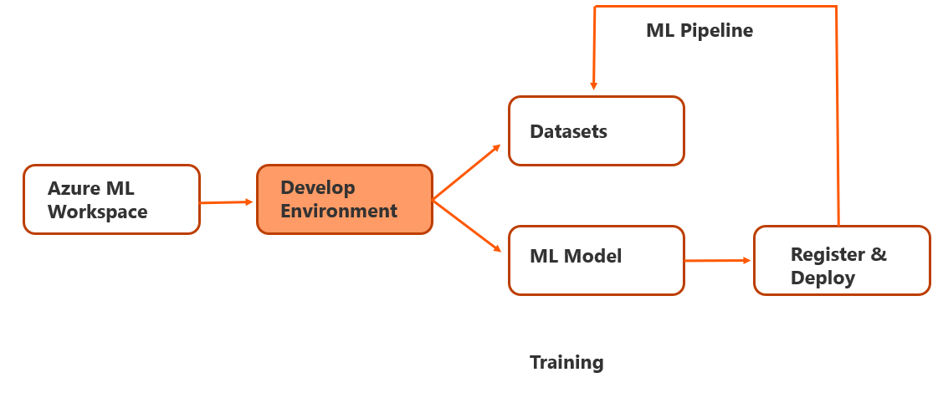
Development Environment
After creating the ML workspace, next step is configuring development environment.
Options available in Azure:
DSVM – No setup required & scaling is easier.
Compute Instances – Integrated to the Azure ML Workspaces and have Jupyter notebooks & other IDE’s mounted in the shared file system.

Slide 19
Development Environment - Data Science VM
The Data Science Virtual Machine (DSVM) is a customized VM image on the Azure cloud platform built specifically for doing data science. It has many popular data science tools preinstalled and pre-configured to jump-start building intelligent applications for advanced analytics.
The DSVM is available on:
Windows Server 2019
Ubuntu 18.04 LTS
Ubuntu 20.04 LTS
https://docs.microsoft.com/en-us/azure/machine-learning/data-science-virtual-machine/overview

Slide 20
Setup DSVM for Windows
Go to the Azure portal, You might be prompted to sign in to your Azure account if you're not already signed in.
Find the virtual machine listing by typing in "data science virtual machine" and selecting "Data Science Virtual Machine - Windows 2019."
Select the Create button at the bottom.
You should be redirected to the "Create a virtual machine" blade.
Fill in the Basics tab:
Subscription: If you have more than one subscription, select the one on which the machine will be created and billed. You must have resource creation privileges for this subscription.
Resource group: Create a new group or use an existing one.
Virtual machine name: Enter the name of the virtual machine. This is how it will appear in your Azure portal.
Location: Select the datacenter that's most appropriate. For fastest network access, it's the datacenter that has most of your data or is closest to your physical location.
Image: Leave the default value.
https://docs.microsoft.com/en-us/azure/machine-learning/data-science-virtual-machine/provision-vm

Slide 21
Setup DSVM for Windows
Size: This should auto-populate with a size that is appropriate for general workloads. Read more about Windows VM sizes in Azure.
Username: Enter the administrator username. This is the username you will use to log into your virtual machine and need not be the same as your Azure username.
Password: Enter the password you will use to log into your virtual machine.
Select Review + create.
Review+create
Verify that all the information you entered is correct.
Select Create.
For more info on DSVM, Read the article Data Science with a Windows Data Science Virtual Machine in Azure

Slide 22
Demo: Data Science VM
Configure & Explore DSVM

Slide 23
Development Environment - Compute in Azure ML
One of the benefits of Azure Machine Learning is the ability to create cloud-based compute on which you can run experiments and training scripts at scale.
In Azure Machine Learning studio, view the Compute page. This is where we will manage compute resources for your data science activities. There are four kinds of compute resource we can create:
Compute instances: Development workstation that data scientists can use to work with data and models. Used mainly on azure notebooks like Jupyter, RStudio, VSCode or Terminal.
Compute clusters: Scalable clusters of virtual machines for on-demand processing of experiment code. Utilized in designer and supports batch inferencing.
Inference clusters: Deployment targets for predictive services that use your trained models. Used for real-time inferencing.
Attached compute: Links to other Azure compute resources, such as Virtual Machines or Azure Databricks clusters. Provides option to bring compute from local compute or Azure Databricks, HD Insights etc.
Option to select processing type: CPU, GPU, FGPA.
For the demos , we mostly use compute instance & compute clusters in the AML workspace.

Slide 24
Create a compute instance
On the Compute instances tab, add a new compute instance with the following settings. You’ll use this as a workstation to run code in notebooks.
Compute name: enter a unique name
Location: The same location as your workspace
Virtual machine type: CPU
Virtual machine size: Standard_DS11_v2
Total Available Quotas: This shows dedicated cores available.
Show advanced settings: Note the following settings, but do not select them:
Enable SSH access: Unselected (you can use this to enable direct access to the virtual machine using an SSH client)
Enable virtual network: Unselected (you would typically use this in an enterprise environment to enhance network security)
Assign to another user: Unselected (you can use this to assign a compute instance to a data scientist).
Wait for the compute instance to start and its state to change to Running.

Slide 25
Stop compute instance
If you’ve finished exploring Azure Machine Learning for now, you should shut down your compute instance to avoid incurring unnecessary charges in your Azure subscription.
In Azure Machine Learning studio, on the Compute page, select your compute instance.
Click Stop to stop your compute instance. When it has shut down, its status will change to Stopped.

Slide 26
Demo: Compute Instance
Create & Test Compute Instance in Azure ML Studio.

Slide 27
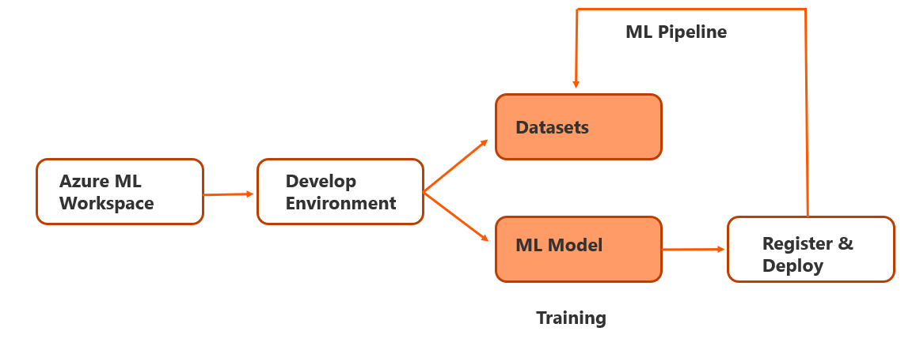
Training ML models
Here, we work on modelling data based on the dataset to create best performing models with code or without code.
Options available to build ML model in Azure:
Azure ML Designer.
Azure Notebooks.
Azure AutoML.

Slide 28
Working with Data in Azure ML Studio
Register the Dataset to use in AML.
Options to connect data in AML.
Locally (upload directly to AML from desktop).
Web Files (e.g., GitHub).
Azure datastores (e.g., Azure SQL DB, Blob storage and Data lake).
Types of Dataset in AML.
Tabular: Displays data in table format e.g., Parquet, csv, tsv, json etc.
File : Connects to files in the data store or public URL( like open datasets).

Slide 29
Demo: Azure Data Assets
Create a Datastore & Select data from the datastore.
Register dataset in Azure ML Studio

Slide 30
Model Training -Azure ML Designer
Azure ML Designer is a drag and drop option to build experiments and deploy machine learning pipelines.
The Components of designer:
Pipelines - Includes the dataset and analytical modules.
Datasets - Consists of several data samples used to perform experiments.
Components - An algorithm used to perform on the data.
Compute resources - Resources used to run the pipeline.
Deploy - Perform real-time inferencing through endpoint.
Publish - Similar to real-time endpoint, additionally pipeline runs from external applications using REST.

Slide 31
Demo: Azure ML Designer
Explore the Azure ML Designer
Create Compute in Azure ML Designer
Select ML Algorithm in Azure Ml Designer
Deploy Azure ML Designer Environment.

Slide 32
Model Training - Automated Machine Learning(AutoML)
AutoML builds the best ml model rapidly by automating the iterative process of training and evaluating models.
Azure Machine Learning offers two experiences to work with automated ML:
Azure ML SDK (Code based Version)
Azure ML Studio (No-Code based Version)
AutoML can be used for: Classification, Regression, Time-series forecasting.
AutoML Steps:
Identify ML Problem,
Choose platform to work with AutoML,
Selection of data source,
Compute target configuration,
Configure AutoML parameters,
Training run submission,
Review results,
Publish the selected model.

Slide 33
Azure Machine Learning SDK
Manage and interact with Azure services programmatically in language of developer's choice.
Full control of development environment and dependencies involved.
Azure SDK Documentation : https://docs.microsoft.com/en-us/azure/developer/
GitHub URL: https://github.com/Azure/azure-sdk

Slide 34
Exploring Azure Machine Learning SDK
A lot of data science and machine learning experimentation is performed by running code in notebooks.
The compute instance includes fully featured Python notebook environments (Jupyter, JuypyterLab, VS Code) that we can use for extensive work; but for basic notebook editing, we can use the built-in Notebooks page in Azure Machine learning studio.
In Azure Machine Learning studio, view the Notebooks page.
If a message describing new features is displayed, close it.
Select Terminal or the Open terminal icon to open a terminal and ensure that its Compute is set to your compute instance and that the current path is the /users/your-user-name folder.
Enter the following command to clone a Git repository containing notebooks, data, and other files to your workspace: git clone https://github.com/sebastianbirk/datascience-bootcamp
When the command has completed, in the Files pane, click ↻ to refresh the view and verify that a new /users/your-user-name/datascience-bootcamp folder has been created. This folder contains multiple .ipynb notebook files.
Close the terminal pane, terminating the session.
In the /users/your-user-name/datascience-bootcamp folder, open a notebook. Then read the notes and follow the instructions it contains.

Slide 35
Demo: AutoML
AutoML run in Azure Machine Learning Studio.
AutoML run in Azure Machine Learning SDK.

Slide 36
Model Training - Azure Notebooks
The Compute instance of Azure ML studio has Jupyter or VS code installation included to initiate or control the model training.
For example: If we want to use notebook to run ML experiments in the Jupyter home page, browse to the /users/your-user-name/foldername, where the notebooks can be created.
Then write code in the notebook running each code in turn.
When finished with running code in notebook, on the 'File' menu, click 'Close and Halt' to close and shut down the Python kernel. Then close all Jupyter browser tabs.

Slide 37
Demo: Azure Notebooks
Training regression-based model using Azure SDK.

Slide 38

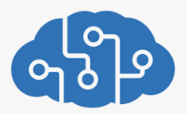

Azure Cognitive Services
Microsoft Azure
Algorithm
REST API
Data
Model
Azure Cognitive Services
Application
Azure Cognitive Services are cloud-based artificial intelligence (AI) services that help to build cognitive intelligence into your applications.

Slide 39
Azure Cognitive Services Types
Vision | Speech | Language | Decision
Computer Vision | Speech to Text | Entity recognition | Anamoly Detector
Custom Vision | Text to Speech | Sentiment Analysis | Content Moderator
Face API | Speech Translation | Question Answering | Personalizer
 | Speaker Recognition | Conversational language understanding (Preview)
 |  | Translator
https://azure.microsoft.com/en-us/services/cognitive-services/#api

Slide 40
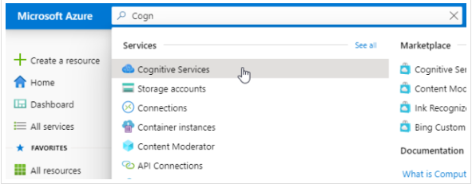

Working with Cognitive Services
REST API
Create Cognitive service in Azure Portal.
Customize and Train Model (only for custom data services).
Call Cognitive services from application via
REST API.

Slide 41
Create Cognitive Services using Azure Portal
You can access Azure Cognitive Services through two different resources:
Multi-service : Access multiple Azure Cognitive Services with a single key and endpoint.
Single-service : Access a single Azure Cognitive Service with a unique key and endpoint for each service created.
For this exercise, we will create multi-service resource named as Cognitive Services in the portal.
The multi-service resource enables access to the following Cognitive Services:
Decision - Content Moderator
Language - Language, Translator
Speech - Speech
Vision - Computer Vision, Custom Vision, Face

Slide 42
Create Cognitive Services using Azure Portal
You can select this link to create an Azure Cognitive multi-service resource: Create a Cognitive Services resource.
On the Create page, provide the following information:
Subscription: Select one of your available Azure subscriptions.
Resource group: The Azure resource group that will contain your Cognitive Services resource. You can create a new group or add it to a pre-existing group.
Region: The location of your cognitive service instance. Different locations may introduce latency but have no impact on the runtime availability of your resource.
Name: A descriptive name for your cognitive services resource.
Pricing tier: The cost of your Cognitive Services account depends on the options you choose and your usage.
Configure additional settings for your resource as needed, read and accept the conditions (as applicable), and then select Review + create.
After your resource is successfully deployed, select Next Steps > Go to resource.
From the quickstart pane that opens, you can access the resource endpoint and manage keys.

Slide 43
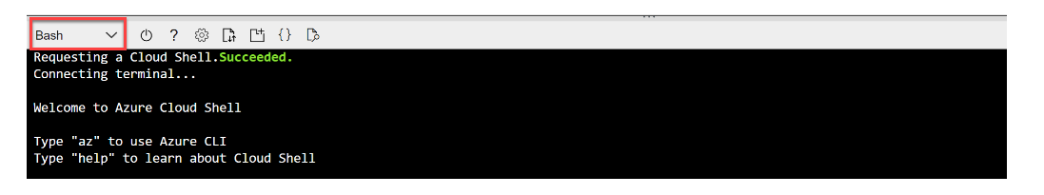
Computer Vision Service
To test the capabilities of the Computer Vision service, we'll use a simple command-line application that runs in the Cloud Shell on Azure.
In the Azure portal, select the [>_] (Cloud Shell) button at the top of the page to the right of the search box. This opens a Cloud Shell pane at the bottom of the portal.
The first time you open the Cloud Shell, you may be prompted to choose the type of shell you want to use (Bash or PowerShell). Select PowerShell. If you do not see this option, skip the step.
If you are prompted to create storage for your Cloud Shell, ensure your subscription is specified and select Create storage. Then wait a minute or so for the storage to be created.
Make sure the type of shell indicated on the top left of the Cloud Shell pane is switched to PowerShell. If it is Bash, switch to PowerShell by using the drop-down menu. Wait for PowerShell to start.
https://docs.microsoft.com/en-us/learn/modules/analyze-images-computer-vision/3-analyze-images

Slide 44
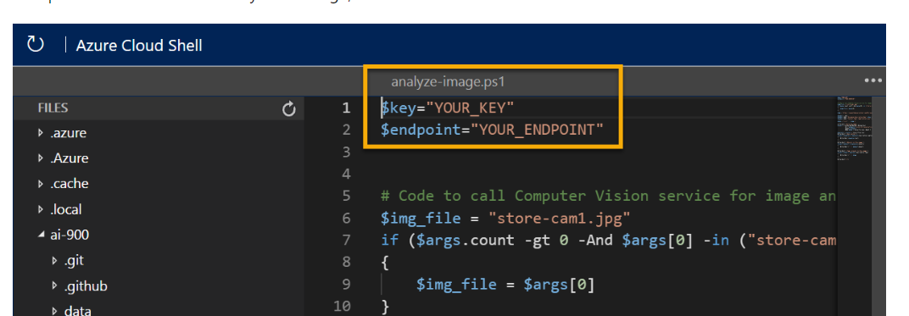
Configure and run client application
Now. you can run a simple application that uses the Computer Vision service to analyze an image.
In the command shell, enter - git clone https://github.com/MicrosoftLearning/AI-900-AIFundamentals ai-900
The files are downloaded to a folder ai-900 Now we want to see all of the files in your Cloud Shell storage and work with them. Type the following command into the shell: code .
In the Files pane on the left, expand ‘ai-900’ and select ‘analyze-image.ps1’. This file contains some code that uses the Computer Vision service to analyze an image, as shown here:
At the top right of the editor pane, use the ... button to open the menu and select Save to save your changes.
Go the Keys and Endpoints page for your resource from the Azure portal and paste them into the code editor.

Slide 45

Exercise 1
The sample client application will use your Computer Vision service to analyze the following image, taken by a camera in the Northwind Traders store:
In the PowerShell pane, enter the following commands to run the code:
cd ai-900
./analyze-image.ps1 store-camera-1.jpg
Review the results of the image analysis, which include:
A suggested caption that describes the image.
A list of objects identified in the image.
A list of "tags" that are relevant to the image.

Slide 46


Exercise 2
./analyze-image.ps1 store-camera-2.jpg
./analyze-image.ps1 store-camera-2.jpg

Slide 47
Create a Custom Vision project
To train an object detection model, you need to create a Custom Vision project based on your training resource. To do this, you'll use the Custom Vision portal.
Download and extract the training images from https://aka.ms/fruit-images. These images are provided in a zipped folder, which when extracted contains subfolders called apple, banana, and orange.
In another browser tab, open the Custom Vision portal at https://customvision.ai. If prompted, sign in using the Microsoft account associated with your Azure subscription and agree to the terms of service.
In the Custom Vision portal, create a new project with the following settings:
Name: Grocery Checkout
Description: Image classification for groceries
Resource: The Custom Vision resource you created previously
Project Types: Classification
Classification Types: Multiclass (single tag per image)
Domains: Food
https://docs.microsoft.com/en-us/learn/modules/classify-images-custom-vision/3-create-image-classifier

Slide 48
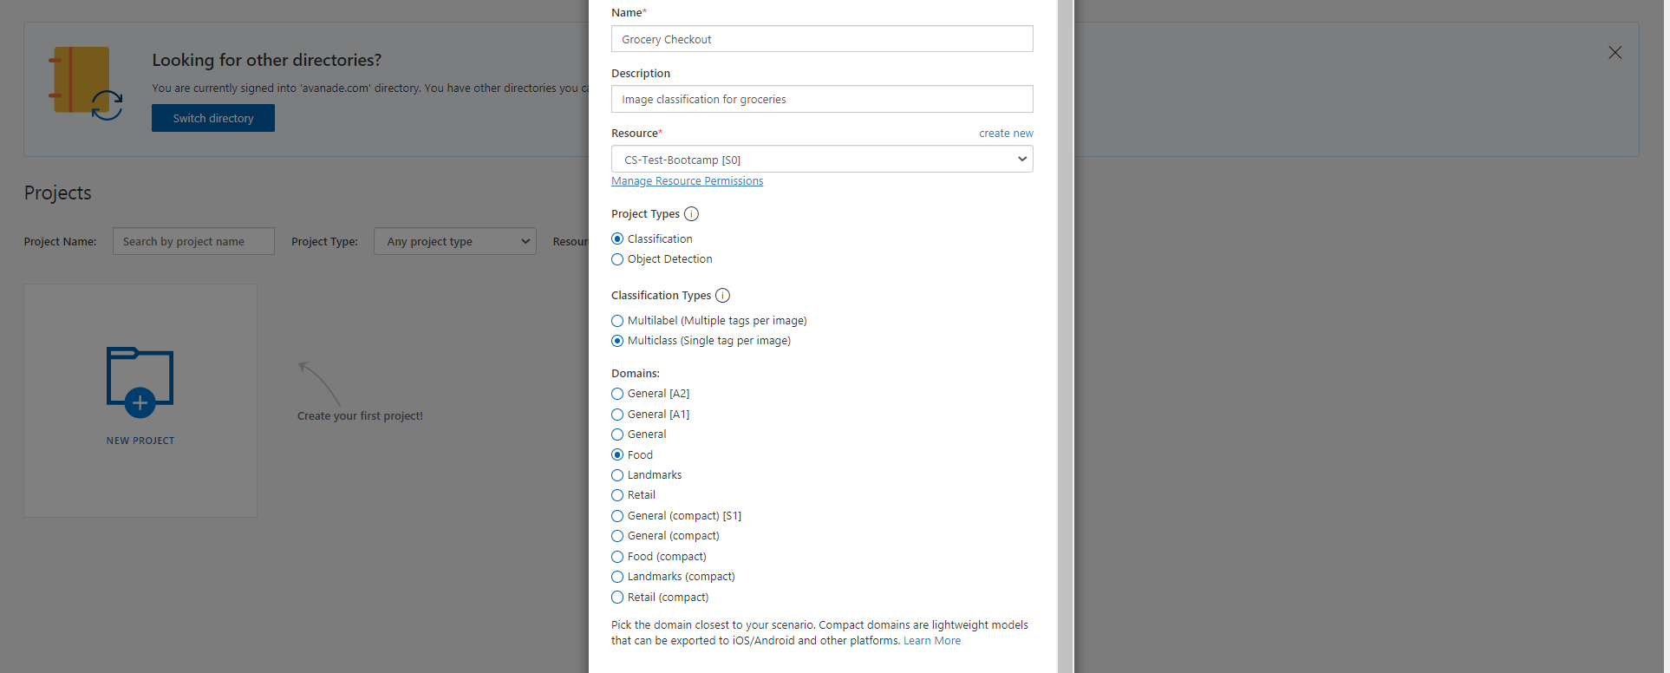
Create a Custom Vision project

Slide 49
Create a Custom Vision project
Click [+] Add images, and select all of the files in the apple folder you extracted previously. Then upload the image files, specifying the tag apple.
Repeat the previous step to upload the images in the banana folder with the tag banana, and the images in the orange folder with the tag orange.
Explore the images you have uploaded in the Custom Vision project - there should be 15 images of each class.
In the Custom Vision project, above the images, click Train to train a classification model using the tagged images. Select the Quick Training option, and then wait for the training iteration to complete (this may take a minute or so).
When the model iteration has been trained, review the Precision, Recall, and AP performance metrics - these measure the prediction accuracy of the classification model, and should all be high.

Slide 50
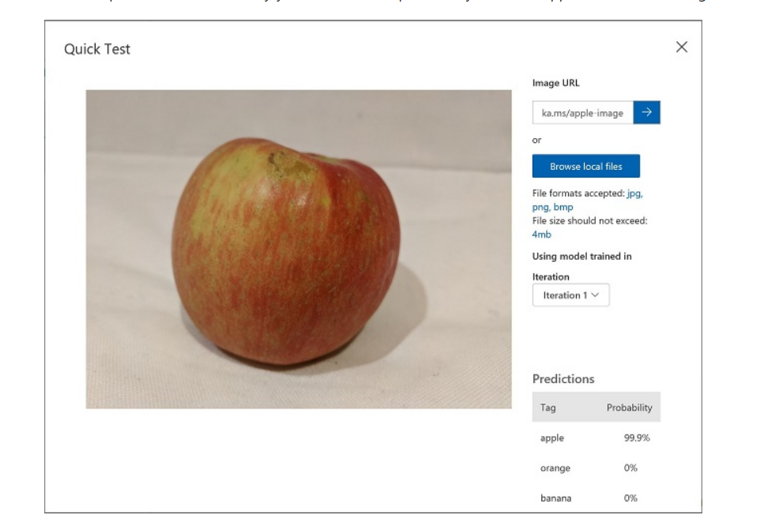
Test the Model
Before publishing this iteration of the model for applications to use, you should test it.
Above the performance metrics, click Quick Test.
In the Image URL box, type https://aka.ms/apple-image and click ➔
View the predictions returned by your model - the probability score for apple should be the highest, like the image:
Close the Quick Test window.

Slide 51
Publish the model
Click 🗸 Publish to publish the trained model with the following settings:
Model name: groceries
Prediction Resource: The prediction resource you created previously.
After publishing, click the Prediction URL (🌐) icon to see information required to use the published model. Later, you will need the appropriate URL and Prediction-Key values to get a prediction from an Image URL, so keep this dialog box open and carry on to the next task.

Slide 52
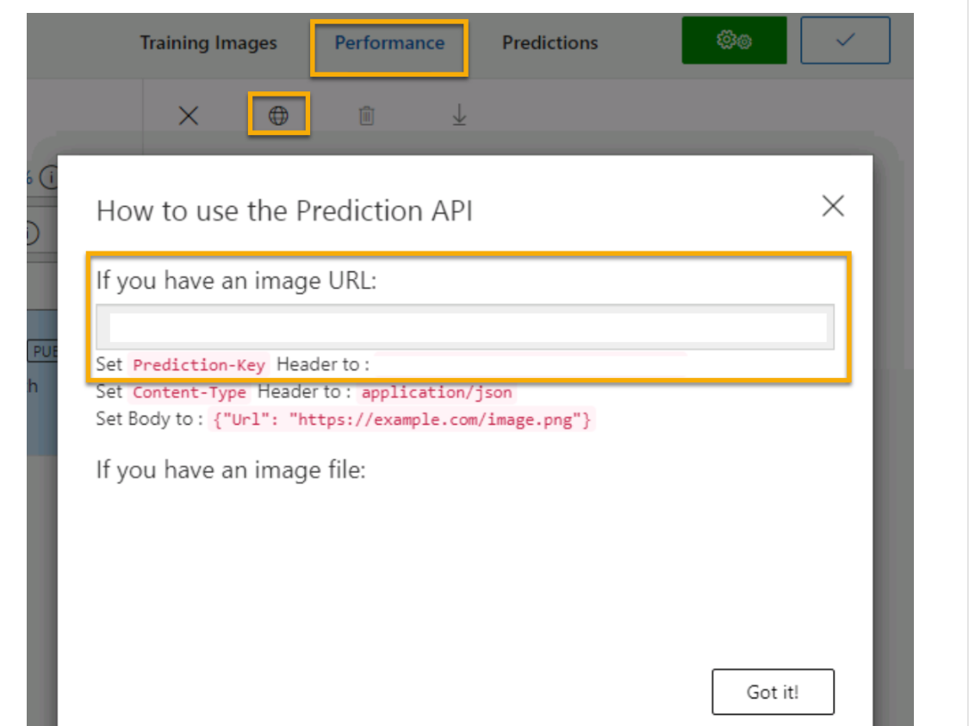
Test model in Azure portal
To test the capabilities of the Custom Vision service, we'll use a simple command-line application that runs in the Cloud Shell on Azure.
Configure and run a client application like Custom vision service in cloud shell.
Enter the following git command: git clone https://github.com/MicrosoftLearning/AI-900-AIFundamentals ai-900
The files are downloaded to a folder ai-900. Now we want to see all of the files in your Cloud Shell storage and work with them. Type the following command into the shell: code .
In the Files pane on the left, expand ‘ai-900’ and select ‘classify-image.ps1’. This file contains some code that uses the Custom Vision service to analyze an image, as shown here:
At the top right of the editor pane, use the ... button to open the menu and select Save to save your changes.
Get the prediction URL & key from the dialog box in Custom Vision project.

Slide 53
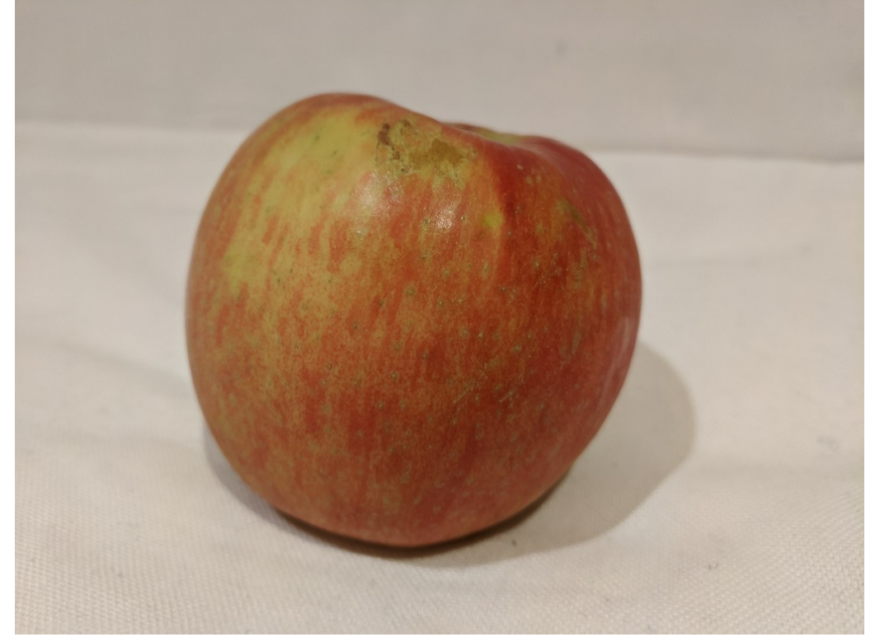
Exercise 1
You will use the sample client application to classify several images into the apple, banana, or orange category.
We will classify this image:
./classify-image.ps1 1
Review the prediction, which should be apple.

Slide 54
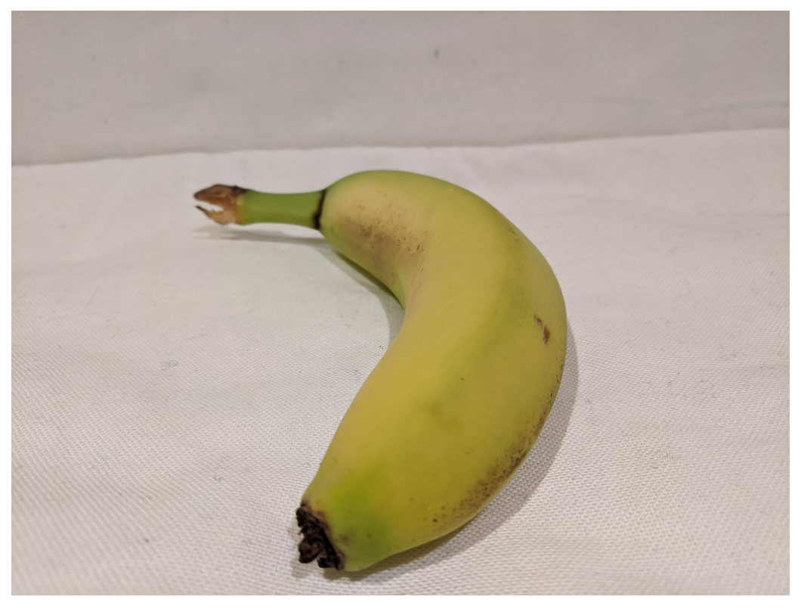
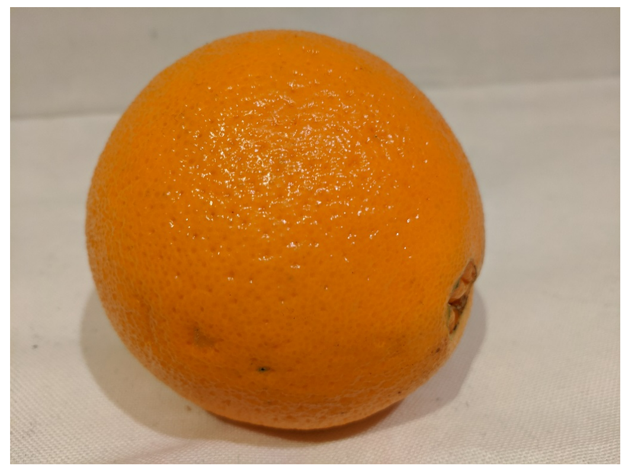
Exercise 2
./classify-image.ps1 2
./classify-image.ps1 3

Slide 55
Demo: Azure Cognitive Services
- Computer Vision
- Custom Vision

Slide 56
Azure Databricks
Azure Databricks is a data analytics platform optimized for the Microsoft Azure cloud services. Built on Spark-based platform that can be used for data processing and interactive data science collaboration.
Azure Databricks offers three environments for developing data intensive applications:
Databricks SQL,
Databricks Data Science & Engineering, and
Databricks Machine Learning.

Slide 57
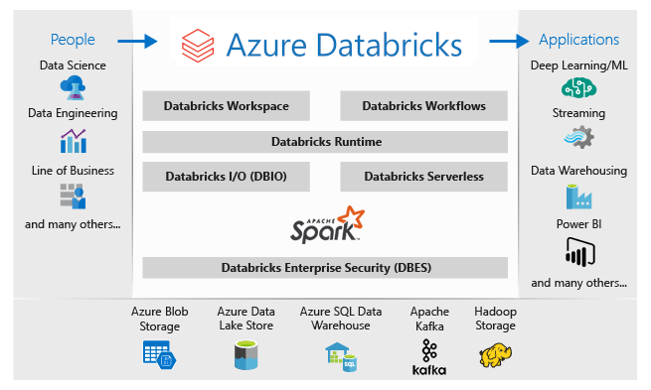
Databricks Data Science & Engineering
https://docs.microsoft.com/en-us/azure/databricks/scenarios/what-is-azure-databricks-ws

Slide 58
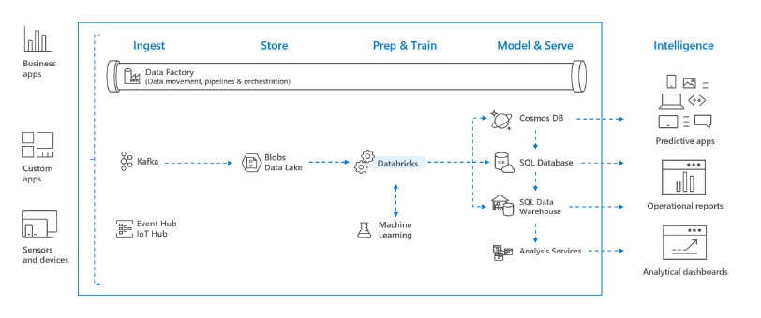
Data Pipeline and Azure Databricks
https://docs.microsoft.com/en-us/azure/databricks/scenarios/what-is-azure-databricks-ws

Slide 59
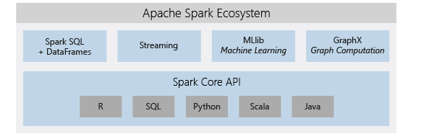
Apache Spark analytics platform
https://docs.microsoft.com/en-us/azure/databricks/scenarios/what-is-azure-databricks-ws

Slide 60
Components of Azure Databricks:
Components of Azure Databricks:
Workspace.
Cluster.
Notebooks.
Tables.
Jobs

Slide 61
Create Azure Databricks Workspace using Azure portal
In the Azure portal, select Create a resource > Analytics > Azure Databricks.
Under Azure Databricks Service, provide the values to create a Databricks workspace.
Workspace name: Provide a name for your Databricks workspace.
Subscription: Select one of your available Azure subscriptions.
Resource group: Specify whether you want to create a new resource group or use an existing one. A resource group is a container that holds related resources for an Azure solution..
Location: Select West Europe.
Pricing tier: Choose between Standard, Premium, or Trial.
Select Review + Create, and then Create. The workspace creation takes a few minutes. During workspace creation, you can view the deployment status in Notifications. Once this process is finished, your user account is automatically added as an admin user in the workspace.
After your resource is successfully deployed, select Next Steps > Go to resource that redirects to Azure Databricks page.
https://docs.microsoft.com/en-us/azure/databricks/scenarios/quickstart-create-databricks-workspace-portal?tabs=azure-portal

Slide 62
Demo: Setup of Azure Databricks
- Walkthrough of Azure databricks workspace.
Create Cluster
Create Notebook.

Slide 63



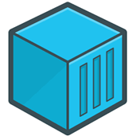
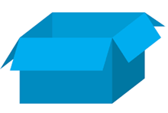
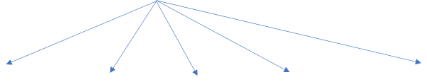
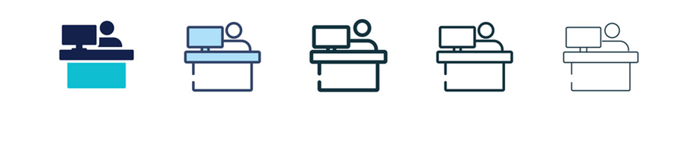
Illustration on Docker
Developer
Container
Docker

Slide 64
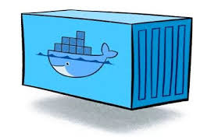

Docker Workflow
Docker Image
Developer
pull
image
Docker Container
Docker Image
Docker Hub
build
Push
image
Docker Image
run
Dockerfile
pull
image
Docker Container
Docker Container

Slide 65
Docker
Docker is a software platform used to build, test and deploy applications quickly.
Two options to setup docker environment:
Docker Desktop - Windows, Linux or MAC OS.
Play with Docker – Modern Browser and Docker Hub account required (https://labs.play-with-docker.com/) .

Slide 66
Basic Commands in docker
Install docker for Windows, Linux or MacOS.
Open the command at the root folder of the application.
Build a custom docker image: Run docker build –t <image name> .
List all docker containers : docker ps –a.
Try to run container from image in ‘detached’ mode with external and container port of 80 : docker run –d –p 80:80 docker/getting-started.
Stop container : docker stop ‘first two characters of the image‘ & docker –rm ‘first two characters of the image‘
Help with commands: docker build –help.

Slide 67
Demo: Play with Docker
Basic docker commands.

